Slide 1
DEVELOPMENT OF SOFTWARE FOR FLOWER RECOGNITION USING IMAGE PROCESSING TECHNIQUE
Major Advisor:
Er. Salam Din
Associate professor
By:
Gurleen Kaur
L-2013-AE-149-M
School of Electrical Engineering & Information Technology
College of Agricultural Engineering and Technology
PUNJAB AGRICULTURAL UNIVERSITY
LUDHIANA

Slide 2
Introduction
Identification of flower is important as:
It will help natural resource managers in identification of similar plants as flowers will be their differentiating factor
The ability to know or identify flowers allows us to assess many important rangeland or pasture variables that may help horticulture experts and taxonomists
It will help experts and students in their research work

Slide 3
Identifying flowers is a crucial but unsure task without help of proper protocol
Help either from web pages or guide books is restricted to keywords, hence not feasible for naïve person
Several research works are conducted for this purpose but very few with the help of image processing techniques

Slide 4
Objectives
To develop software for flower recognition using image processing techniques.
Prototype implementation and testing of the software.

Slide 5
Review of literature
Das et al. gave a technique of flower patent image indexing with help of location’s domain knowledge and colour information
Saitoh et al. introduced idea of using clustering algorithm for automatic identification of wild flowers
Hong et al. gave an approach based on region of interest. In addition to approach of Das et al. colour histogram was calculated

Slide 6
Zou et al. proposed a interactive flower recognition model based on Computer Assisted Visual Inter Active Recognition.
Nilsback et al. investigated to what extend vocabulary of visual words be a significant distinguishing characteristic
Fukuda et al. developed a image retrieval system to classify various flowers through Fuzzy C-means clustering algorithm

Slide 7
Holmes et al. explained interactive feature extraction from coloured images and supervised learning of a software to identify region of interest
Kim et al. gave limitations and restrictions of conventional flower or leaf recognition studies
Singh et al. proved the importance of histogram processing for effective image enhancement

Slide 8
Vibhute et al. conducted a research study focussing on application of image processing techniques in various agricultural fields
Aleya et al. proposed histogram approach to detect diseases of flowers with help of stem values
Apriyanti et al. proposed HSV colour feature and SVM methods to identify different species of orchids

Slide 9
Tiay et al. used image processing techniques for classification of flowers on basis of colour and edge characteristics

Slide 10
Material and Methodology
24 species of flowers are used in this project.
Digital image of these winter annual flowers were taken by scanning them with white background.

Slide 11
Technologies Used
Java SE platform at front end
The integrated development environment (IDE) used is Eclipse Lunar
Java language and OpenCV libraries are used for writing the source code
Java Swings are used for making user interface
MYSQL server 5.5 at back end

Slide 12
Limitations of Existing Software
Commercial neural network based software can only be used with basic knowledge of plants and its features
Software which uses image processing techniques processes only Bitmap (.bmp) images
Processing is done on flower image as a single entity without acknowledging its sub parts

Slide 13
Proposed Software
Can be used by naïve user who has no knowledge of keywords related to flower taxonomy
Compatible with 32-bit as well as 64-bit processors.
Input image can be taken from any scanner and is file format independent
A new feature stamen/pistil area is included for identification

Slide 14
Image processing techniques
Conversion of RGB colour model to HSV colour model is done through function cvtColor(). This function gives the information regarding hue, saturation and luminance
Histogram of H-plane is calculated through a function called calcHist() after eliminating the saturation and luminance information
Dominant colour of flower is the 2nd maxima value of histogram

Slide 15
Color image segmentation is done once the color of flower is found, we can segment out the flower from background through function inRange()
Contours are detected and various noises are discarded by using functions such as findContours() and contourArea()
Hu-moments are selected as a shape comparison method. And this technique is used in matchShapes() function

Slide 16
A bounding box is created for largest contour i.e. the flower
To create the region of interest calculation of of 34% of previous width and 1/3rd of previous height is done
Then the stamen/pistil region of interest is normalized by using function normalize()
Relative stamen/pistil area is compared with some relaxation here using REL_AREA_TH

Slide 19
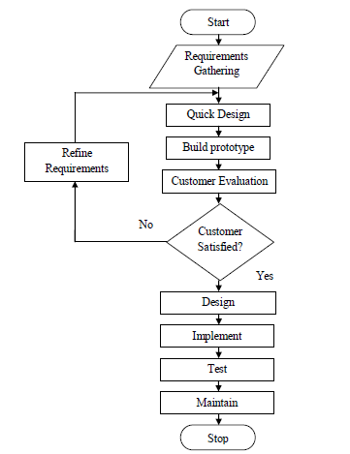
Testing

Slide 20
Deployment
When a java based software is created 2 types of files are used in it .java files and .class files
To make the software run without the help of any IDE like eclipse, deployment can be done
A file format of .exe file is created and to run this file all we need is java virtual machine

Slide 22
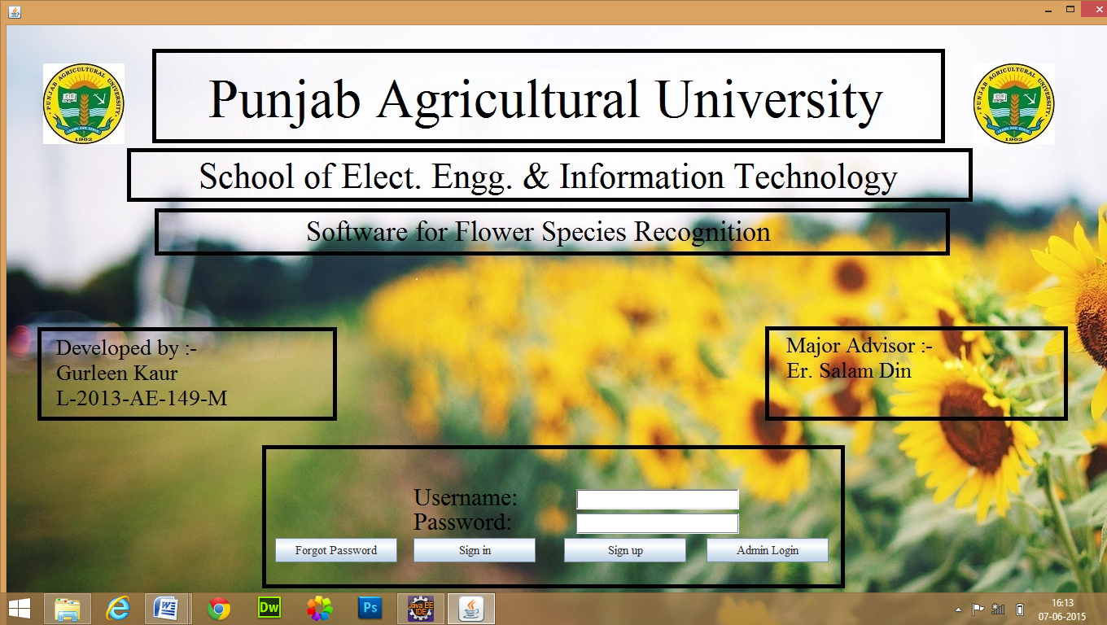

Slide 23
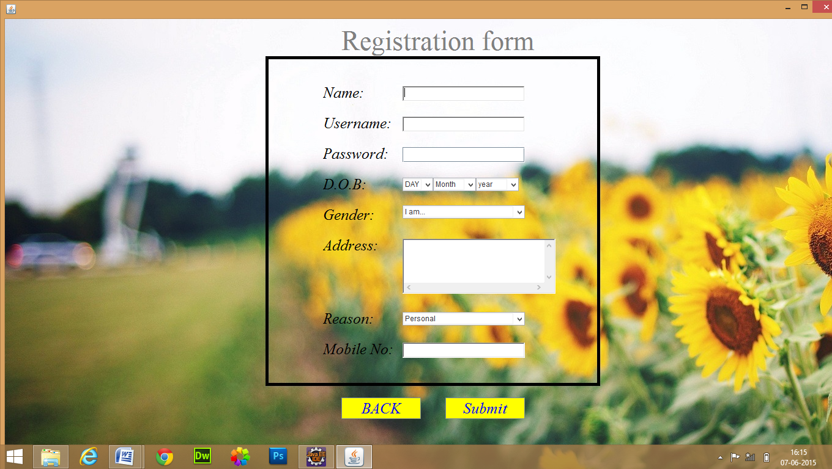

Slide 26
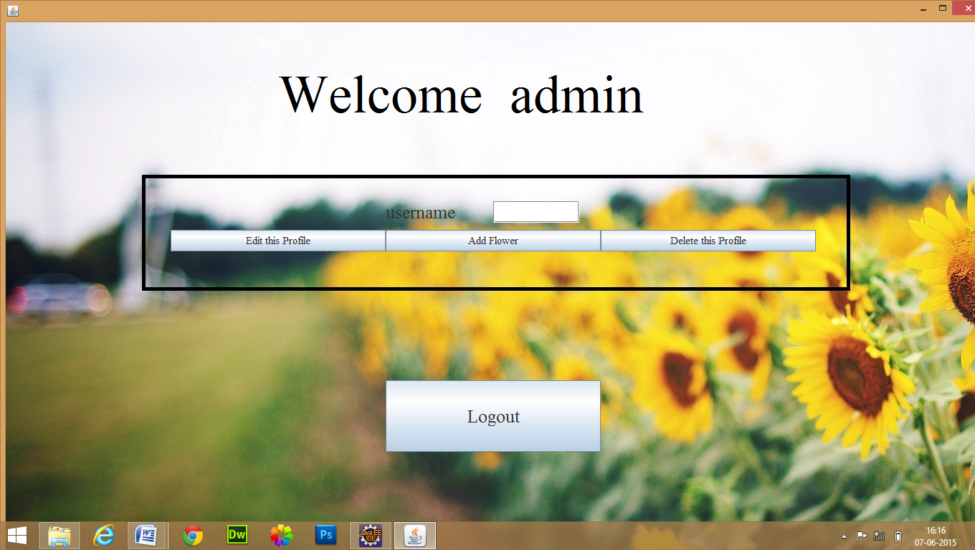

Slide 27
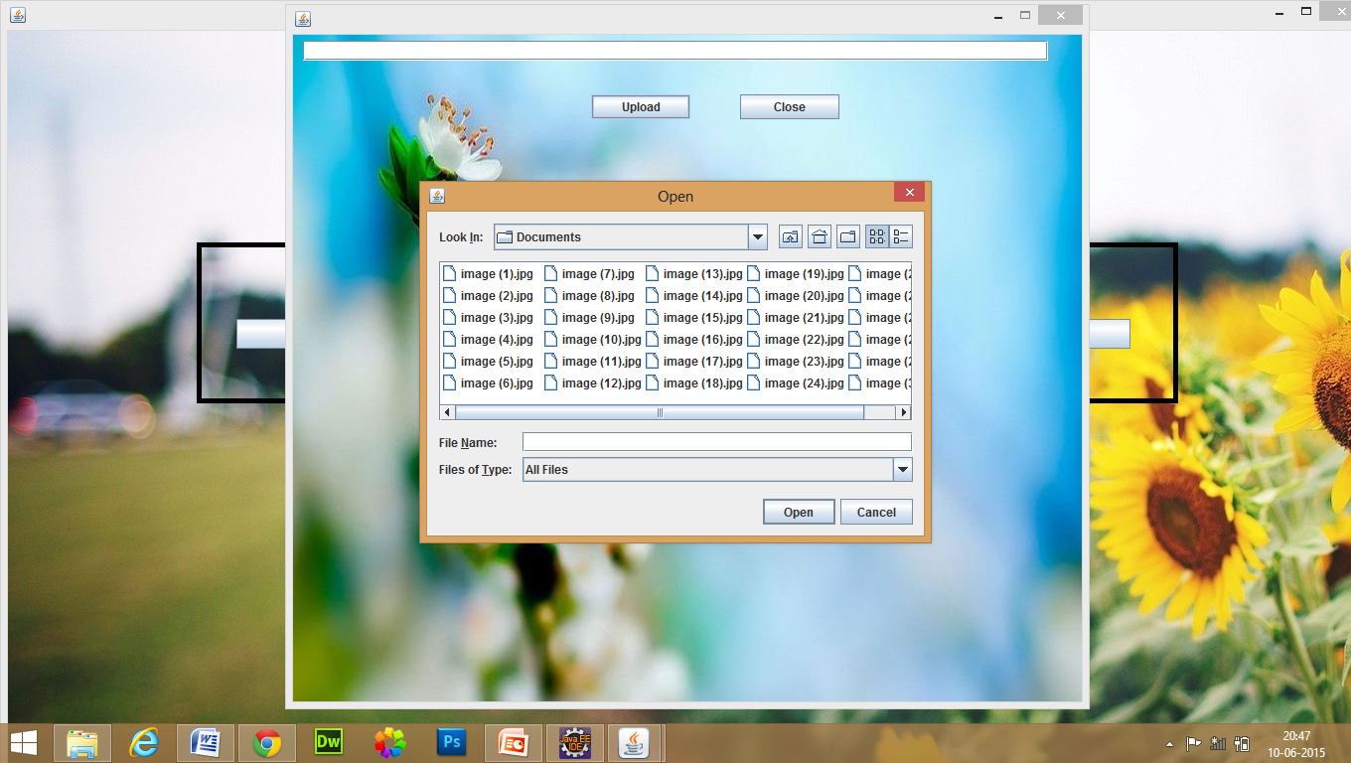

Slide 28
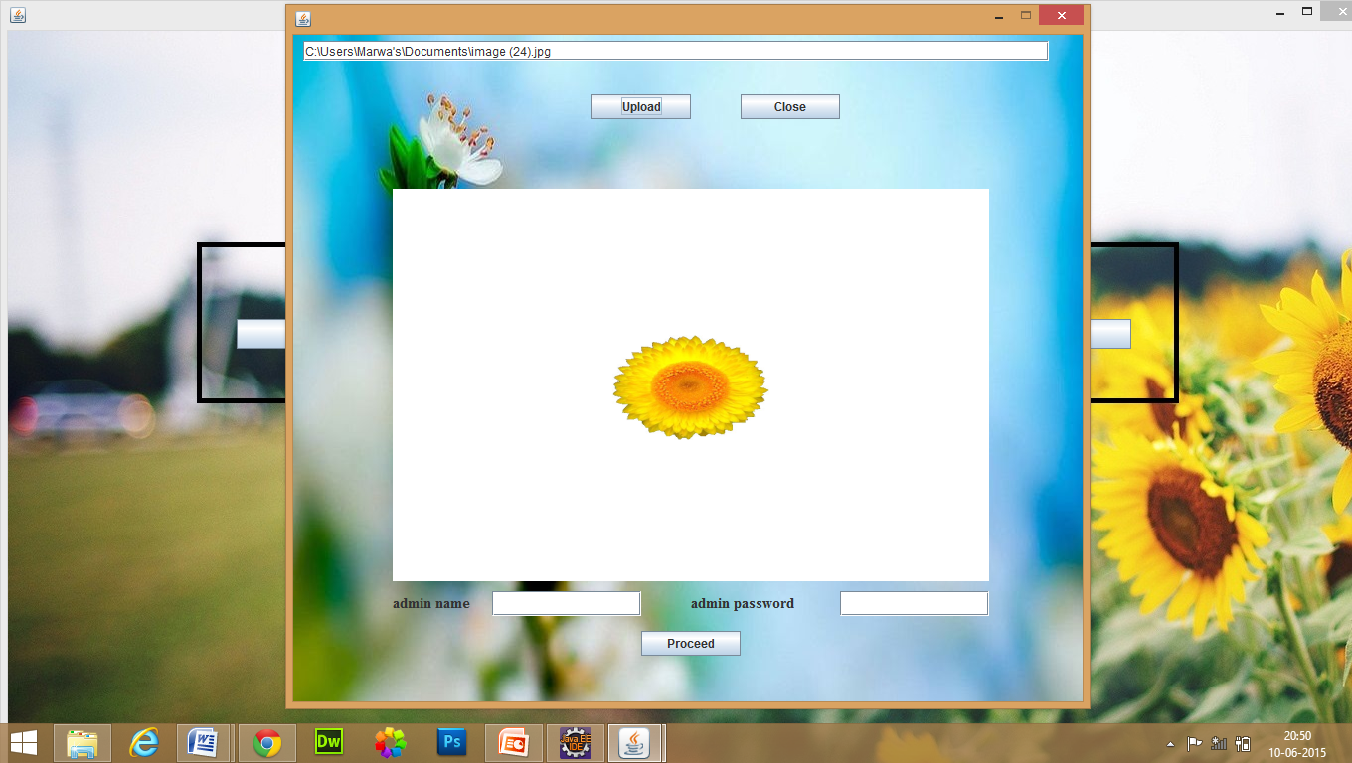

Slide 30
Results and Discussion
Method | Recognition rate%
Proposed approach 1 (using only color feature) | 12.3
Proposed approach 2 (using color and shape feature) | 75.3
Proposed approach 3 (using color, shape and pistil/ stamen feature) | 83.0

Slide 31
Thus, a new developed software can be considered as
Inexpensive
More accurate
Scanner Independent
Suitable for non-expert
methodology for recognition of flowers.

Slide 32
Thank You

